Slide 1

Lords Institute of Engineering and Technology
CSE-DS
DEPARTMENT OF CSE-DS
Presentation on
FAKE IMAGE DETECTION USING CNN
Group 3:
Syeda Marriya Jaffar (160920750003)
Noreen Ayesha (160920750014)
Saba Siddiqui (160920750057)
Mini project Co-ordinators:
Mr. Syed Mushtaq Ali (Asst. professor LIET)
Mr. feroz Amer (Associate. professor LIET)
Under the guidance of
Mrs. Y. Shakuntala (Asst. professor LIET)

Slide 2
TABLE OF CONTENTS
ABSTRACT
EXISTING SYSTEM
PROPOSED SYSTEM
SYSTEM REQUIREMENTS
ALGORITHM
CLASS DIAGRAM
USE CASE DIAGRAM
SEQUENCE DIAGRAM
FINAL EXECUTION

Slide 3
CSE-DS
ABSTRACT
In this technological era, social media has a major role in people’s daily life. Images are one of the most common types of media share among users on social media.
It has become easy for individuals and small groups to fabricate these images.
This research attempted to propose an approach to extracting image content, classify it and verify the authenticity of digital images and uncover manipulation.
Lords institute of engineering and technology

Slide 4
CSE-DS
Existing system
The identification of fake news and images is very difficult, as a fact-finding of news on a pure basis remains an open problem and few existing models Can be used to resolve the problem.
It has been proposed to study the problem of “detecting false news”.
There are some hidden characteristics in words and images used in fake news, which can be identified through a collection of hidden properties derived from this model through various layers.
Lords institute of engineering and technology

Slide 5
CSE-DS
Proposed System
To overcome from this problem we are using new technique called Deep Texture Features extraction from images and then building train machine learning model using CNN (Convolution Neural Networks) algorithm.
This technique refer as LBPNet or NLBPNet as this technique heavily dependent on features extraction using LBP (Local Binary Pattern) algorithm.
Here first we will extract LBP from images and then train LBP descriptor images with Convolution Neural Network to generate training model.
Lords institute of engineering and technology

Slide 6
CSE-DS
SYSTEM REQUIREMENTS
HARDWARE REQUIREMENTS:
Processor - Intel i3 or i5
Speed - 1.1 GHz
RAM - 4 GB (min)
Hard Disk - 500 GB(min)
Key Board - Standard Windows
Keyboard Mouse - Two or Three Button Mouse
Monitor - SVGA
Lords institute of engineering and technology

Slide 7
CSE-DS
SOFTWARE REQUIREMENTS
Operating System - Windows 10 or above
Programming Language – Python
Lords institute of engineering and technology

Slide 8
algorithm
CSE-DS
Step 1: START
Step 2: Download Data
Step 3: Create folders (ex. Classes01, Classes02 etc..)
Step 4: Under each class proceed with creating two directories “Original” and “Photoshopped”
Step 5: Create Tests folders (Ex. Test01, Test02 etc.)
Step 6: Pick ~500 image from each class under ./Classes01/original and ./Classes01/photoshopped and paste them under ./Test01/original and ./Test01/photoshopped resp.
Step 7: Call process_filter_on_data() to populate the new training dataset with appropriate filter applied
Step 8: Update the dir_src_1 and dir_src_2 in the process_filter_on_data() and repeat the process for the test data
Step 9: this will create the filtered images under the different sub-directories to be used in testing.
Step 10: END

Slide 9
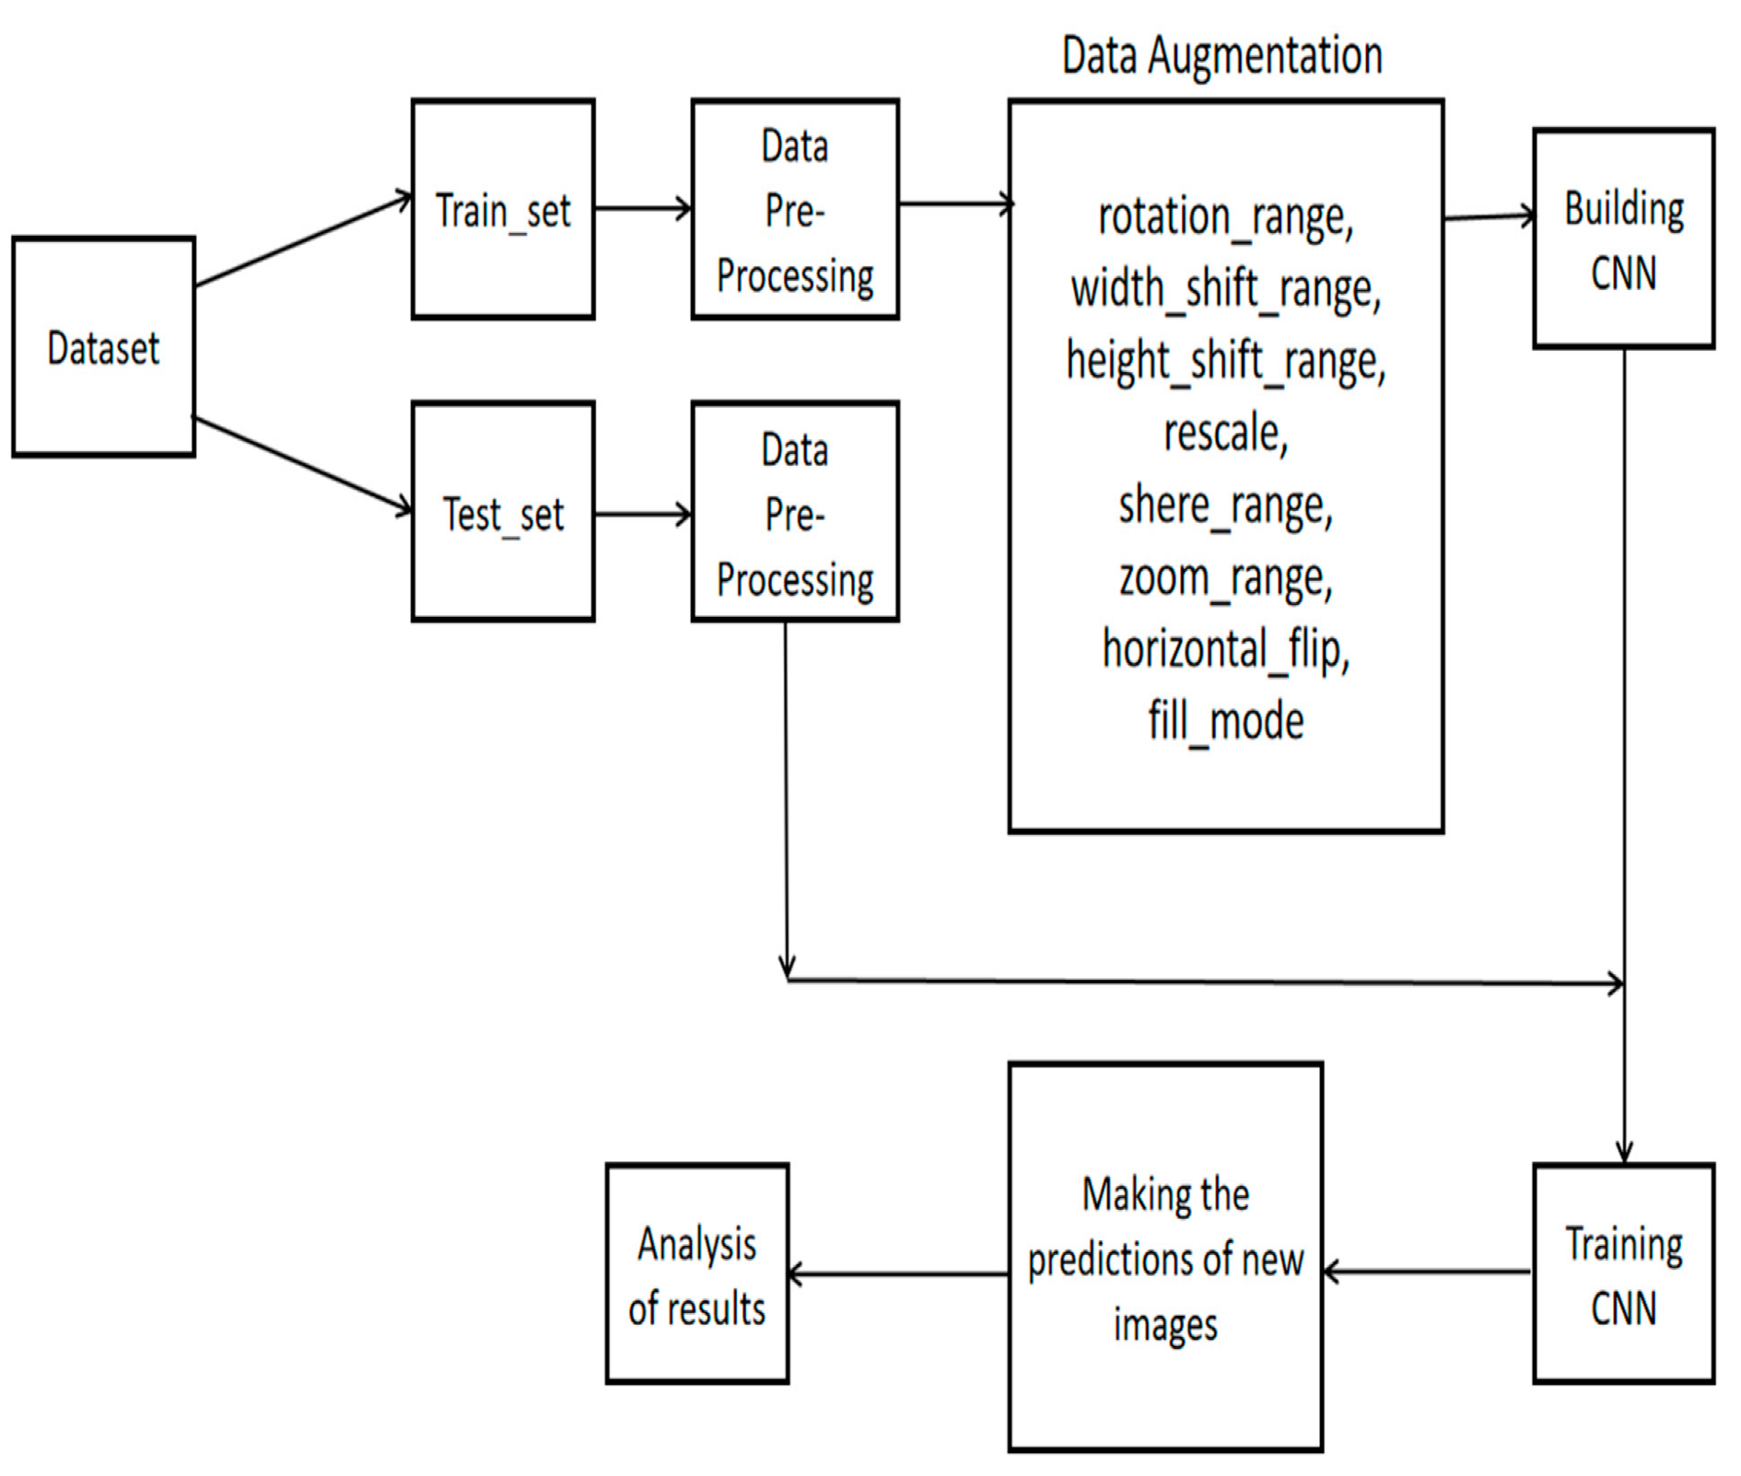
Class diagram
The class diagram is the main building block of object oriented modelling.
It is used both for:
general conceptual modeling of the systematic of the application
detailed modelling translating the models into programming code.

Slide 10
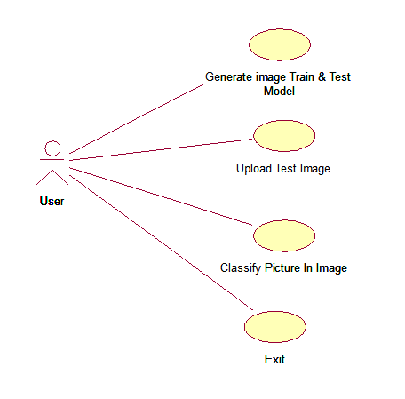
USE case diagram
CSE-DS
A use case diagram at its simplest is a representation of a user's interaction with the system
depicting the specifications of a use case.
A use case diagram can portray the different types of users of a system and the various ways that they interact with the system.

Slide 11
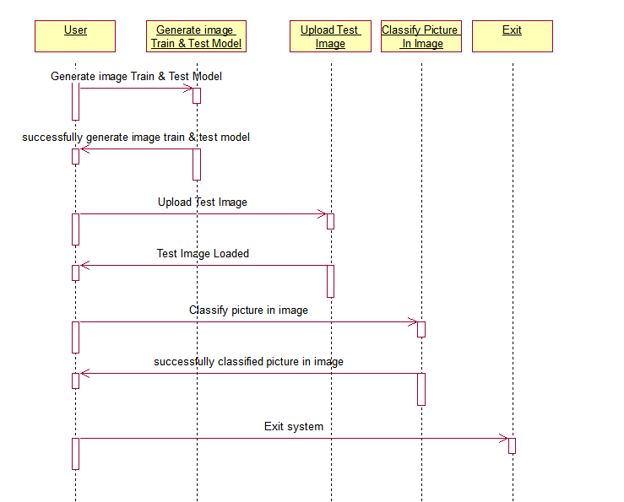
Sequence diagram
CSE-DS
A sequence diagram is a kind of interaction diagram that shows how processes operate with one another and in what order
It depicts the objects and classes involved in the scenario and the sequence of messages exchanged between them
Sequence diagrams are sometimes called event diagrams, event scenarios, and timing diagrams.

Slide 12
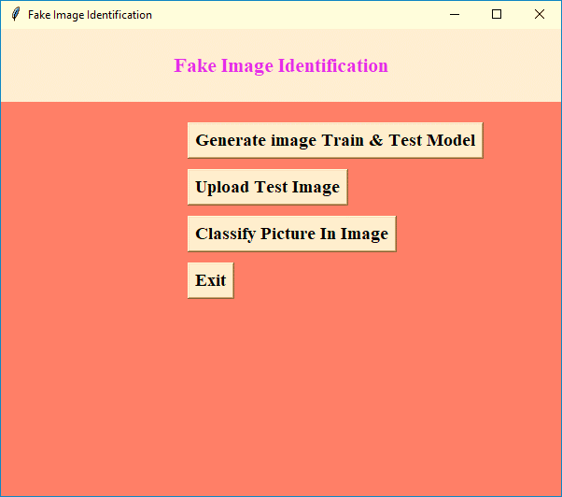
CSE-DS
Lords institute of engineering and technology

Slide 13
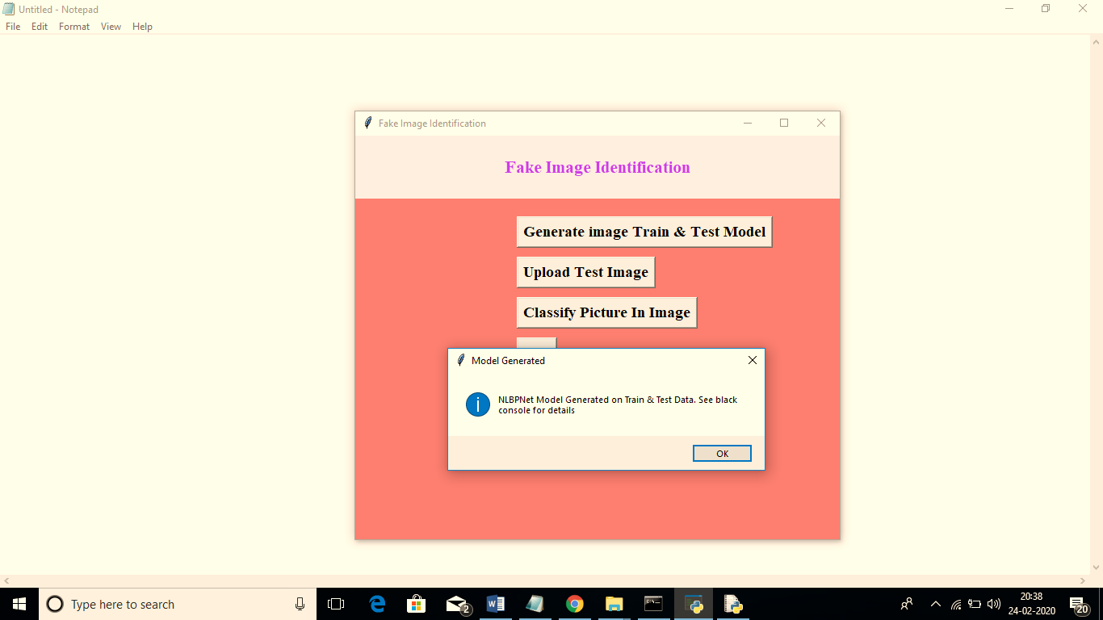
CSE-DS
Lords institute of engineering and technology

Slide 14
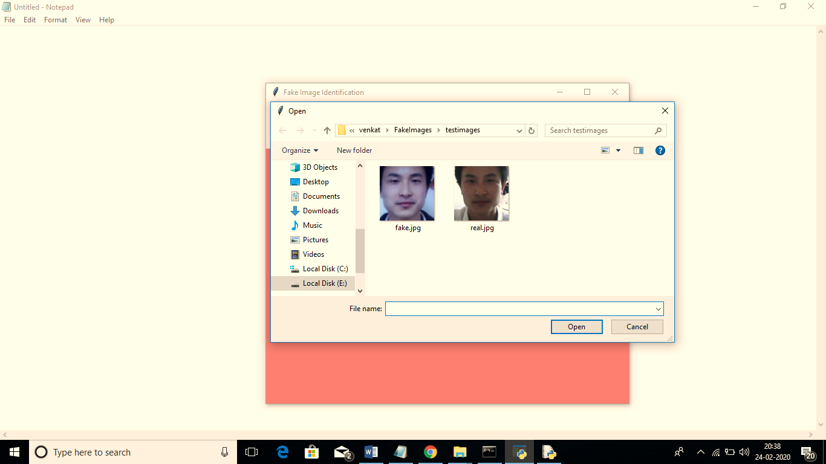
CSE-DS
Lords institute of engineering and technology

Slide 15
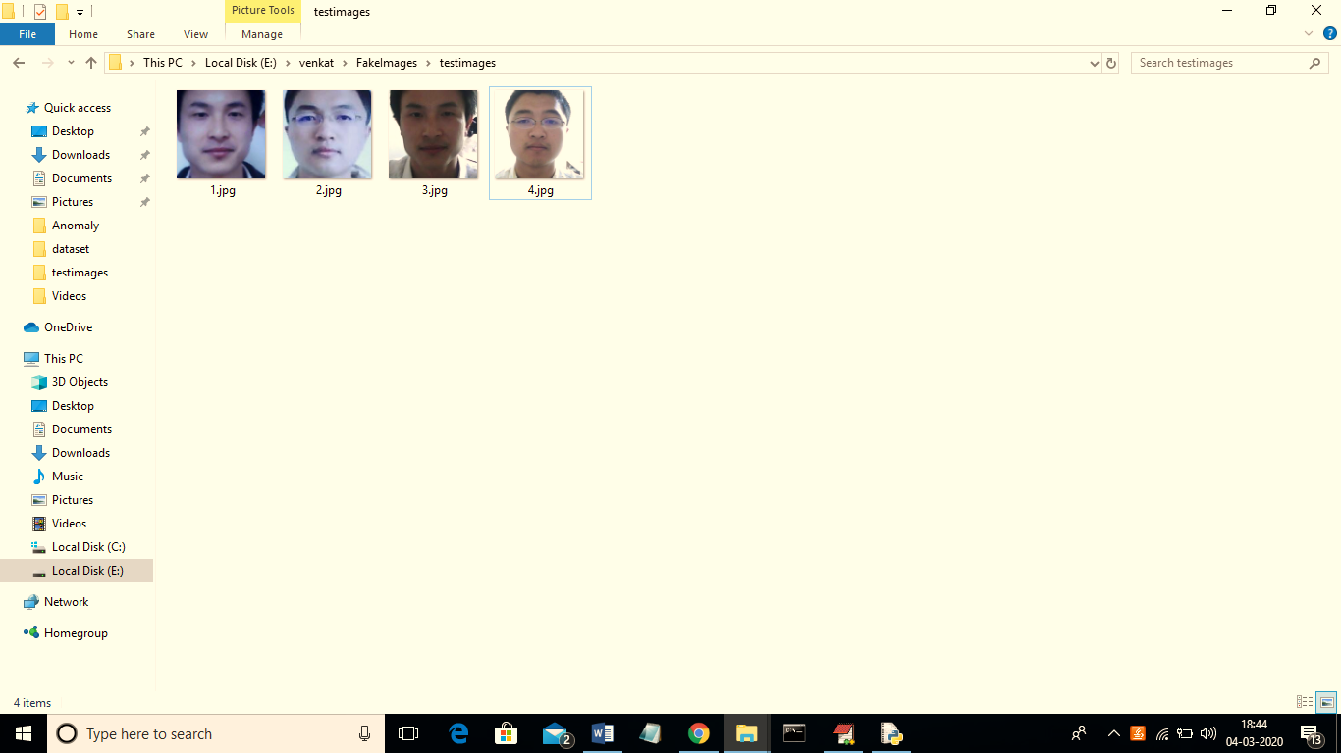
CSE-DS
Lords institute of engineering and technology

Slide 16
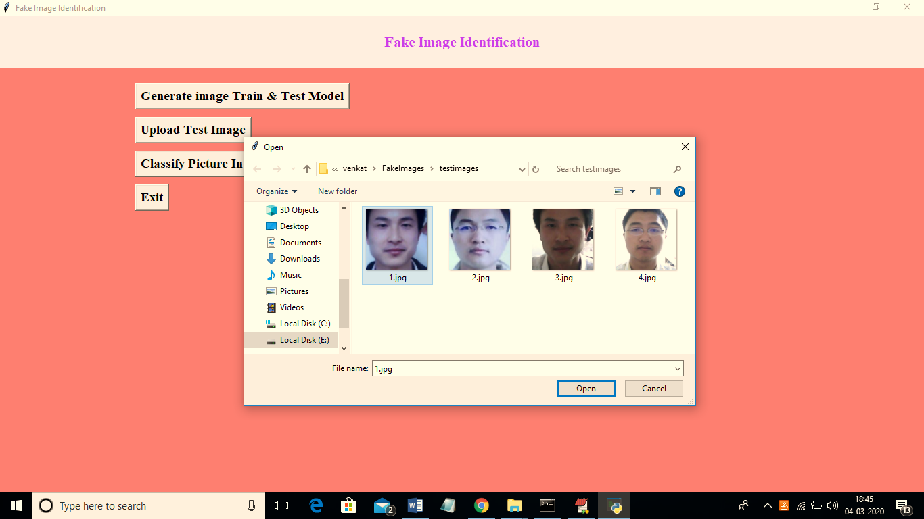
CSE-DS
Lords institute of engineering and technology

Slide 17
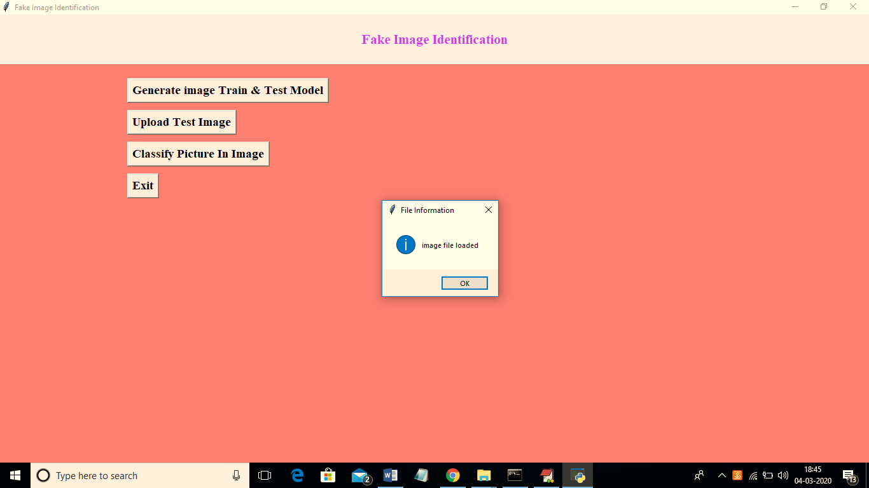
CSE-DS
Lords institute of engineering and technology

Slide 18
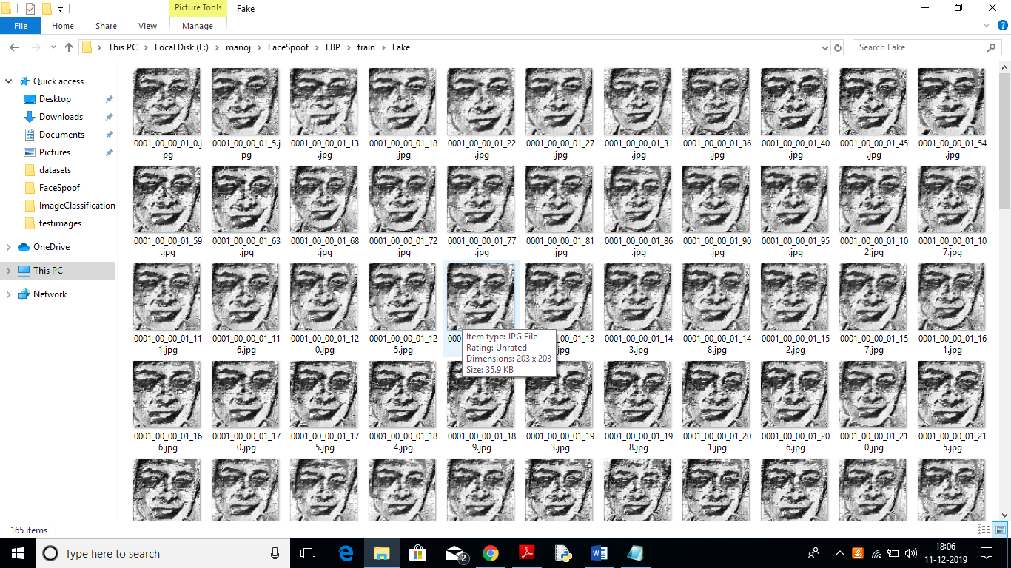
CSE-DS
Lords institute of engineering and technology

Slide 19
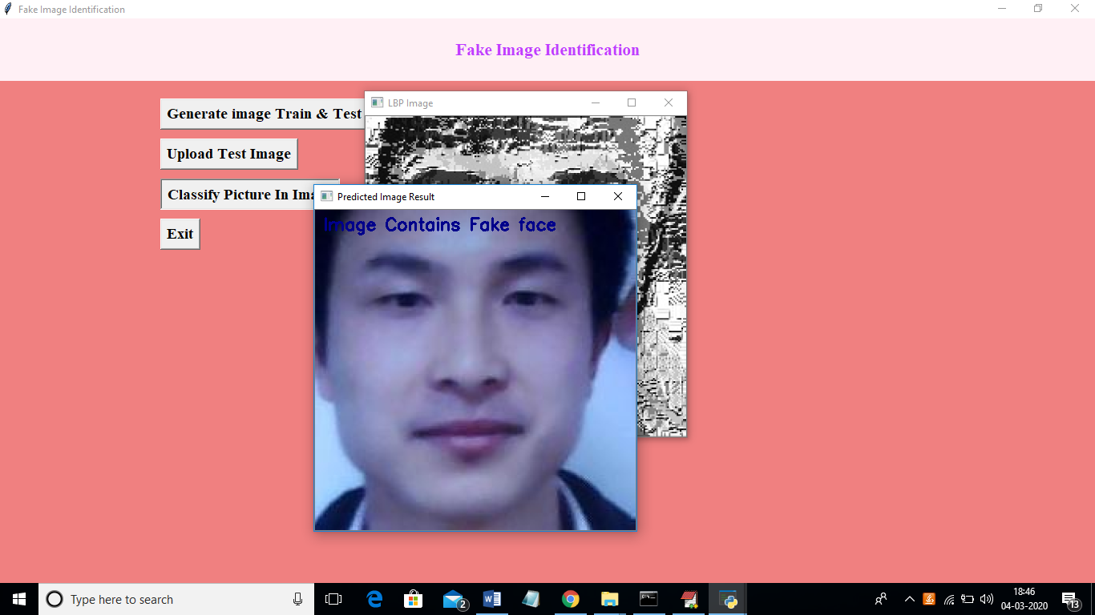
CSE-DS
Lords institute of engineering and technology

Slide 20
CONCLUSION
In order to identify authentic and fake photos, this study compares several state-of-the-art pre-trained deep learning models.
In a future study, we want to generalize our findings. To distinguish between fake and real images using live video recognition, we propose a CNN architecture using different feature extraction techniques. This will provide the highest accuracy on many data sets.

Slide 21

Thank You!
CSE-DS
Lords institute of engineering and technology

